Slide 1

Data Driven Culture
Abed Bakkour
Notes:
Good afternoon, everyone. Today, we're delving into the realm of data-driven culture, exploring how organizations leverage data to shape their decision-making processes. In a world inundated with information, the ability to harness and interpret data is becoming a key determinant of success in various industries.

Slide 2
Definition of Data-Driven Culture
Comprehensive Cultural Shift
Strategic Asset
Evidence-Based Decision-Making
Shift in Mindset
Data as Decision-Making DNA
Notes:
As we embark on this exploration, it's crucial to grasp the multifaceted nature of a data-driven culture, a concept echoed in various studies and discussions. According to Berndtsson et al. (2020), a data-driven culture is an organizational environment that not only values the collection, analysis, and utilization of data but ingrains these processes into the very fabric of decision-making. It goes beyond merely acknowledging the importance of data; it signifies a cultural shift where data is treated as a strategic asset, shaping the organization's narrative and trajectory.
McAfee and Brynjolfsson (2012) extend this definition by emphasizing the central role of data and analytics in the decision-making landscape. Here, a data-driven culture is one where decision-makers leverage data insights, statistical analyses, and predictive models to inform their choices. It's a departure from traditional decision-making based on intuition or historical practices, instead placing a premium on evidence-based, data-supported strategies.
Moreover, Kaushik's insights from the 2007 video stress the cultural aspect of this definition. He argues that a data-driven culture entails not just utilizing data but fostering an environment where data becomes the language of decision-making. It's a shift in mindset where data isn't merely a tool; it's a shared language spoken across all levels of the organization.
In essence, a comprehensive definition of a data-driven culture encompasses an organizational ethos where data isn't merely a resource but an integral part of the decision-making DNA, influencing strategies, operations, and the very culture of how business is conducted.

Slide 3

Characteristics of a Data-Driven Culture
Decision-Making Grounded in Data and Analytics
Continuous Learning and Improvement
Empowering Employees Through Data Literacy
Integration of Data into Organizational Processes
Strategic Use of Data in Decision-Making Fabric
Adaptation to Changing Business Landscape
Notes:
1. **Decision-Making Grounded in Data and Analytics:**
- According to McAfee and Brynjolfsson (2012), a core characteristic is decision-making that is grounded in data and analytics. This involves moving away from intuition-based decisions to those supported by evidence and insights derived from data.
2. **Continuous Learning and Improvement:**
- As highlighted by Berndtsson et al. (2020), a data-driven culture is marked by a commitment to continuous learning and improvement. Organizations actively seek opportunities to enhance processes and strategies based on ongoing data analysis.
3. **Empowering Employees Through Data Literacy:**
- Building on the idea of a cultural shift, a data-driven culture empowers employees through data literacy. This means providing the skills and knowledge necessary for individuals across the organization to engage meaningfully with data.
4. **Integration of Data into Organizational Processes:**
- Another characteristic, as discussed by McAfee and Brynjolfsson (2012), is the seamless integration of data into organizational processes. In a data-driven culture, data is not treated as an isolated entity but as a key component influencing how day-to-day operations are conducted.
5. **Strategic Use of Data in Decision-Making Fabric:**
- Echoing Berndtsson et al.'s (2020) insights, the characteristics also encompass the strategic use of data as an integral part of the decision-making fabric. This involves weaving data insights into the very fabric of how decisions are conceived and executed.
6. **Adaptation to Changing Business Landscape:**
- In the face of a rapidly changing business landscape, a data-driven culture is adaptable. Organizations can quickly pivot strategies, leveraging real-time data to respond to market shifts, emerging trends, and evolving customer preferences.

Slide 4

Benefits of a Data-Driven Culture
Improved Decision-Making
Increased Efficiency
Enhanced Innovation
Competitive Advantage
Real-Time Adaptation
Customer-Centric Approaches
Notes:
1. **Improved Decision-Making:**
- According to McAfee and Brynjolfsson (2012), one of the primary benefits is improved decision-making. Organizations that embrace data-driven practices are better positioned to make informed choices based on real-time insights.
2. **Increased Efficiency:**
- Data-driven cultures lead to increased operational efficiency. Through the strategic use of data, organizations can identify bottlenecks, streamline processes, and allocate resources more effectively, as indicated by McAfee and Brynjolfsson (2012).
3. **Enhanced Innovation:**
- The infusion of data into decision-making processes fosters a culture of innovation. Berndtsson et al. (2020) note that organizations leveraging data creatively often discover new solutions, products, or services that drive innovation.
4. **Competitive Advantage:**
- Organizations embracing data-driven practices gain a competitive edge. McAfee and Brynjolfsson's (2012) statistical evidence highlights that data-driven companies are not only more productive but also more profitable than their counterparts.
5. **Real-Time Adaptation:**
- In a data-driven culture, real-time adaptation becomes possible. For instance, a retail company utilizing data analytics can swiftly adjust pricing strategies based on market dynamics, ensuring competitiveness.
6. **Customer-Centric Approaches:**
- Kaushik's insights emphasize that a data-driven culture enables organizations to adopt customer-centric approaches. By understanding customer behavior through data, businesses can tailor products and services to meet customer needs effectively.

Slide 5

Navigating Data Transformation: From Analytics to Deployment
Transformational Impact of Big Data
Strategic Deployment Components
Organizational Steps for Successful Deployment
Insights from Avinash Kaushik
Unified Approach to Data Transformation
Continuous Learning and Adaptation
Engagement in Meaningful Discussions
Notes:
**Big Data's Transformative Impact:**
Firstly, let's acknowledge the transformative impact of big data. Statistical evidence consistently supports that companies embracing data-driven practices are not only more productive but also more profitable. The power lies in the strategic use of data to inform decision-making and drive organizational success.
**Strategic Deployment Components:**
Moving forward, we'll explore the critical components of strategic deployment. This involves gaining stakeholder trust, seamlessly integrating technology, ensuring accountability, and measuring the economic value of deployed models. These elements collectively contribute to the successful integration of data science into business operations.
**Organizational Steps for Successful Deployment:**
Transitioning to organizational steps, we'll discuss the importance of specialized roles within data science teams, incorporating deployment experience in job interviews, clearly articulating deployment responsibilities, and, crucially, fostering a data-driven culture. This cultural shift is essential for ensuring the longevity and success of data-driven initiatives.
**Insights from Avinash Kaushik:**
Now, drawing insights from Avinash Kaushik, we'll focus on outcomes, depersonalize decision-making, empower analysts, and implement the Trinity Strategy—comprehensive analysis encompassing click-stream, outcomes, and experience analysis. Kaushik's perspective provides a valuable guide for aligning data initiatives with tangible results.
**Unified Approach to Data Transformation:**
These insights collectively emphasize a unified approach to data transformation, recognizing the interconnected nature of leveraging big data, deploying analytics, and fostering organizational strategies. The journey from analytics to deployment is not a series of isolated steps but a cohesive strategy for sustained success.
**Continuous Learning and Adaptation:**
Throughout this journey, it's essential to view the process as one of continuous learning and adaptation. The business landscape evolves, and so should our data-driven strategies. A mindset of constant improvement ensures relevance and competitiveness.
**Engagement in Meaningful Discussions:**
As we proceed, I encourage you to engage in meaningful discussions. Share your experiences, ask questions, and explore how these principles align with your organizational context. Your active participation will enrich our understanding of fostering a data-driven culture.

Slide 6
Challenges of Establishing a Data-Driven Culture
Resistance to Cultural Change
Lack of Data Literacy and Skills
Data Silos Within the Organization
Privacy and Ethical Concerns
Integration with Existing Systems
Change in Decision-Making Culture
Notes:
1. **Resistance to Cultural Change:**
- Berndtsson et al. (2020) discuss the challenge of resistance to cultural change. Employees and leadership accustomed to traditional decision-making processes may resist the shift toward data-driven practices.
2. **Lack of Data Literacy and Skills:**
- A significant hurdle, as highlighted by Davenport and Malone, is the lack of data literacy and skills within the organization. Building a data-driven culture requires not only technological infrastructure but also a workforce equipped to interpret and utilize data effectively.
3. **Data Silos Within the Organization:**
- Davenport and Malone identify the presence of data silos as a common challenge. Data silos hinder the seamless flow of information across departments, impeding the organization's ability to holistically leverage data for decision-making.
4. **Privacy and Ethical Concerns:**
- As organizations collect and utilize more data, privacy and ethical concerns become pronounced. McAfee and Brynjolfsson (2012) note the importance of addressing these concerns to build and maintain trust among stakeholders.
5. **Integration with Existing Systems:**
- Integrating data-driven practices with existing systems poses a challenge. Successful deployment, as discussed by Davenport and Malone, involves integrating models with the organization's technology stack without disrupting current operations.
6. **Change in Decision-Making Culture:**
- Kaushik's insights emphasize the need for a fundamental change in decision-making culture. Depersonalizing decision-making, where data speaks for itself rather than being perceived as the analyst's opinion, requires a cultural shift that may face resistance.

Slide 7
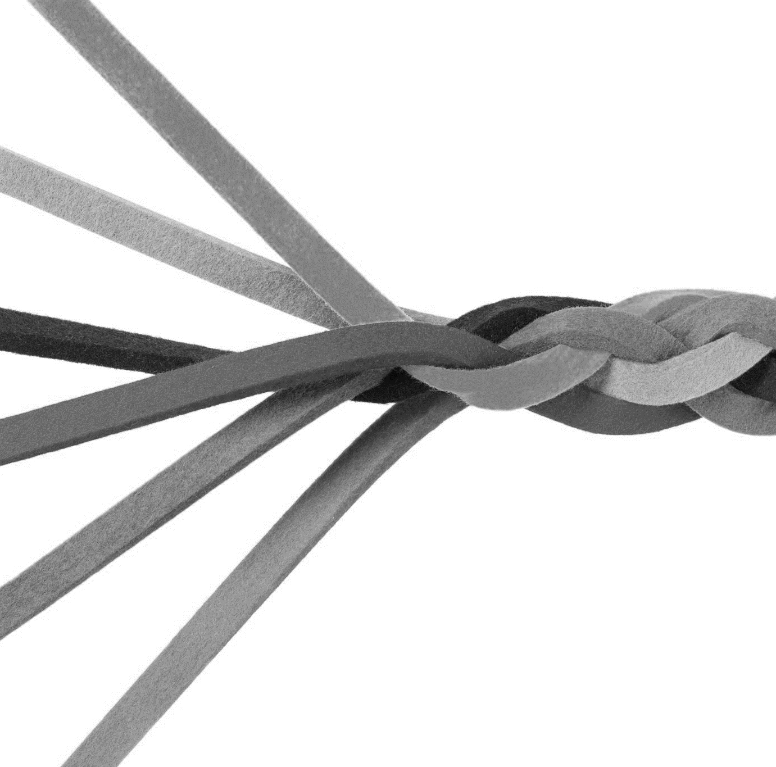
Overcoming Challenges
Change Management as a Key Enabler
Skill Development Programs
Breaking Down Data Silos
Privacy and Ethical Guidelines
Strategic Integration with Existing Systems
Cultural Shift in Decision-Making
Notes:
1. **Change Management as a Key Enabler:**
- Berndtsson et al. (2020) highlight that overcoming resistance to cultural change is facilitated by effective change management. Organizations that implement strategic change management initiatives increase the likelihood of successfully transitioning to a data-driven culture.
2. **Skill Development Programs:**
- Addressing the lack of data literacy and skills requires proactive measures. Organizations can implement skill development programs, aligning with the findings of Davenport and Malone. Examples include offering training sessions, workshops, and online courses to enhance data literacy across the workforce.
3. **Breaking Down Data Silos:**
- To combat data silos, organizations can implement strategies to break down barriers between departments. Davenport and Malone emphasize the importance of creating a collaborative environment where data is shared seamlessly across the organization.
4. **Privacy and Ethical Guidelines:**
- Building trust around privacy and ethical concerns involves establishing clear guidelines. McAfee and Brynjolfsson (2012) suggest organizations develop and communicate comprehensive privacy policies and ethical guidelines to address stakeholder concerns.
5. **Strategic Integration with Existing Systems:**
- Successfully integrating data-driven practices with existing systems requires a strategic approach. Davenport and Malone advocate for a comprehensive understanding of the organization's technology stack, ensuring a smooth integration of data-driven models without disrupting current operations.
6. **Cultural Shift in Decision-Making:**
- Kaushik's insights emphasize the need for a cultural shift in decision-making. Organizations can depersonalize decision-making by creating an environment where data speaks for itself. This may involve implementing practices that emphasize the objective nature of data-driven insights.

Slide 8

Opportunities in a Data-Driven Culture
Strategic Decision-Making
Enhancing Customer Experiences
Identifying New Business Opportunities
Improving Operational Efficiency
Implementing the Trinity Strategy
Fostering a Culture of Continuous Improvement
Notes:
1. **Strategic Decision-Making:**
- The opportunities in a data-driven culture are vast. Organizations can leverage data for strategic decision-making, ensuring that choices align with overarching business objectives. For example, a financial institution might use data to assess investment opportunities, optimizing portfolio strategies based on real-time market trends.
2. **Enhancing Customer Experiences:**
- Data-driven cultures provide opportunities to enhance customer experiences. Understanding customer behavior through data analytics enables businesses to tailor products and services, leading to increased customer satisfaction and loyalty.
3. **Identifying New Business Opportunities:**
- The insights derived from data can uncover new business opportunities. For instance, a retail company analyzing consumer trends might identify a niche market, leading to the development of innovative products that meet emerging demands.
4. **Improving Operational Efficiency:**
- Data-driven practices contribute to operational efficiency. Organizations can optimize processes, streamline workflows, and allocate resources more effectively based on data insights. This is exemplified in manufacturing, where data analytics may optimize production schedules and reduce downtime.
5. **Implementing the Trinity Strategy:**
- The Trinity Strategy, as proposed by Avinash Kaushik, offers a unique opportunity for comprehensive analysis. By implementing click-stream analysis, outcomes analysis, and experience analysis, organizations can gain a nuanced understanding of user behavior, outcomes, and overall user experiences, driving positive outcomes.
6. **Fostering a Culture of Continuous Improvement:**
- A data-driven culture fosters continuous improvement. Organizations can adapt to changing market dynamics, refine strategies based on ongoing data analysis, and stay ahead of competitors by embracing a mindset that values learning and improvement.

Slide 9

Thanks for your attention!

